Slide 1
VIRTUALIZATION
Notes:
Module – 3
Virtualized Data Center – Compute
Copyright © 2011 EMC Corporation. Do not Copy - All Rights Reserved.

Slide 2
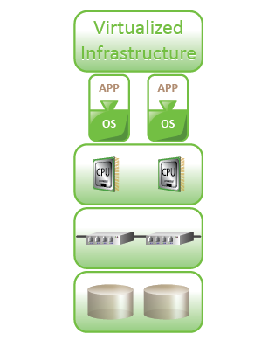
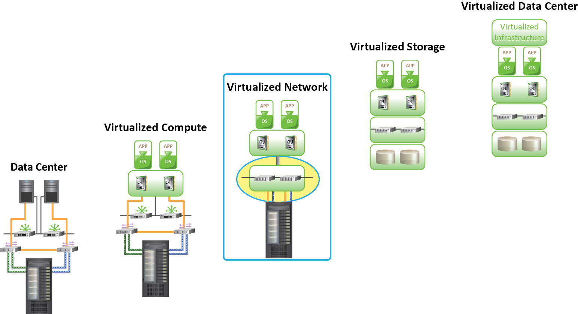
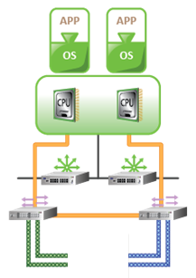
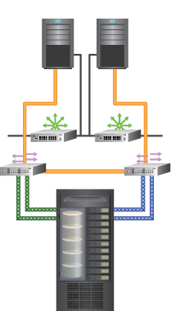
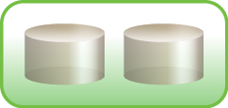
Virtualized Data Center
Transforming a Classic Data Center (CDC) into a Virtualized Data Center (VDC) requires virtualizing the core elements of the data center.
Virtualized Data Center (VDC)
Virtualize Network
Virtualize Storage
Virtualize Compute
Classic Data Center (CDC)
Using a phased approach to a virtualized infrastructure enables smoother transition to virtualize core elements.
Virtualized Data Center – Compute
Notes:
Virtualization is the first step towards building a cloud infrastructure. Transforming a Classic Data Center (CDC) into a Virtualized Data Center (VDC) requires virtualizing the core elements of the data center. A phased approach to virtualize an infrastructure enables a smooth transition from Classic Data Center to Virtualized Data Center .
Copyright © 2011 EMC Corporation. Do not Copy - All Rights Reserved.

Slide 3








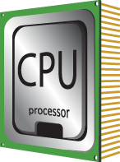
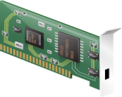
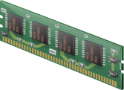
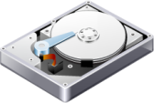
Compute Virtualization
Compute Virtualization
It is a technique of masking or abstracting the physical compute hardware and enabling multiple operating systems (OSs) to run concurrently on a single or clustered physical machine(s).
Enables creation of multiple virtual machines (VMs), each running an OS and application
  VM is a logical entity that looks and behaves like physical machine
Virtualization layer resides between hardware and VMs
  Also known as hypervisor
VMs are provided with standardized hardware resources
Virtualization Layer
x86 Architecture
CPU
NIC Card
Memory
Hard Disk
Virtualized Data Center – Compute
Notes:
Compute virtualization is a technique of masking or abstracting the physical hardware from the operating system and enabling multiple operating systems to run concurrently on a single or clustered physical machine(s). This technique encapsulates an operating system and an application into a portable virtual machine (VM).
A virtual machine is a logical entity that looks and behaves like a physical machine. Each operating system runs on its own virtual machines.
In compute virtualization, a virtualization layer resides between the hardware and virtual machine (on which an operating system is running). The virtualization layer is also known as hypervisor. The hypervisor provides standardized hardware resources (for example: CPU, Memory, Network, etc.) to all the virtual machines.
Note:
The terms physical machine, host machine, compute, and server are interchangeably used throughout the course. The terms virtual machine, guest machine, virtual compute, and virtual server are interchangeably used in this course.
Copyright © 2011 EMC Corporation. Do not Copy - All Rights Reserved.

Slide 4


Need for Compute Virtualization
Hypervisor
x86 Architecture
x86 Architecture
CPU
NIC Card
Memory
Hard Disk
CPU
NIC Card
Memory
Hard Disk
Before Virtualization | After Virtualization
Runs single operating system (OS) per machine at a time Couples s/w and h/w tightly May create conflicts when multiple applications run on the same machine Underutilizes resources Is inflexible and expensive | Runs multiple operating systems (OSs) per machine concurrently Makes OS and applications h/w independent Isolates VM from each other, hence no conflict Improves resource utilization Offers flexible infrastructure at low cost
Virtualized Data Center – Compute
Notes:
Traditionally, one operating system (OS) per compute system (physical machine) is deployed because the operating system and the hardware are tightly coupled and cannot be separated. Only one application is deployed per compute system to minimize the potential resource conflict. This causes organizations to purchase new physical machines for every application they deploy, resulting in expensive and inflexible infrastructure. Further, these compute systems remain underutilized - it is very common to find compute systems running at 15 – 20% utilization. This compounding over many machines within a Classic Data Center (CDC) leads to poor utilization of physical machines.
Compute virtualization enables to overcome these challenges by allowing multiple operating systems and applications to run on a single physical machine. This technique significantly reduces acquisition cost and improves utilization.
Copyright © 2011 EMC Corporation. Do not Copy - All Rights Reserved.

Slide 5


Hypervisor
Hypervisor
It is a software that allows multiple operating systems (OSs) to run concurrently on a physical machine and to interact directly with the physical hardware.
Has two components
  Kernel
  Virtual Machine Monitor (VMM)
VMM
VMM
VMM
Hypervisor (Kernel and VMM)
x86 Architecture
CPU
NIC Card
Memory
Hard Disk
Virtualized Data Center – Compute
Notes:
Hypervisor is a compute virtualization software that enables multiple operating systems (OSs) to run on a physical machine concurrently. The hypervisor interacts directly with the physical resources of the x86 based compute system. The hypervisor is a key component of data center consolidation efforts. By nature, it allows multiple operating systems and applications to reside on the same physical machine.
Hypervisor has two key components: kernel and Virtual Machine Monitor (VMM).
A hypervisor kernel provides the same functionality as other operating systems, such as process creation, file system management, and process scheduling. It is designed to specifically support multiple virtual machines and to provide core functionalities, such as resource scheduling, I/O stacks, etc.
The Virtual Machine Monitor is responsible for actually executing commands on the CPUs and performing Binary Translation (BT). A Virtual Machine Monitor abstracts hardware to appear as a physical machine with its own CPU, memory, and I/O devices. Each virtual machine is assigned a Virtual Machine Monitor that has a share of the CPU, memory, and I/O devices to successfully run the virtual machine. When a virtual machine starts running, the control is transferred to the Virtual Machine Monitor, which subsequently begins executing instructions from the virtual machine.
Copyright © 2011 EMC Corporation. Do not Copy - All Rights Reserved.

Slide 6



Types of Hypervisor
APP
Hypervisor
Hypervisor
Operating System
x86 Architecture
x86 Architecture
CPU
NIC Card
Memory
Hard Disk
CPU
NIC Card
Memory
Hard Disk
Type 1: Bare-Metal Hypervisor
Type 2: Hosted Hypervisor
Type 1: Bare-Metal Hypervisor
It is an operating system (OS) It installs and runs on x86 bare-metal hardware It requires certified hardware
Type 2: Hosted Hypervisor
It installs and runs as an application It relies on operating system (OS) running on physical machine for device support and physical resource management
Virtualized Data Center – Compute
Notes:
Hypervisors are categorized into two types: hosted hypervisor and bare-metal hypervisor.
Type 1 (Bare-metal hypervisor): In this type, the hypervisor is directly installed on the x86 based hardware. Bare-metal hypervisor has direct access to the hardware resources. Hence, it is more efficient than a hosted hypervisor.
Type 2 (Hosted hypervisor): In this type, the hypervisor is installed and run as an application on top of an operating system. Since it is running on an operating system, it supports the broadest range of hardware configurations.
A hypervisor is the primary component of virtualization that enables compute system partitioning (i.e. partitioning of CPU and memory). In this course, we will focus on type 1 hypervisors because it is most predominantly used within Virtualized Data Center (VDC).
Copyright © 2011 EMC Corporation. Do not Copy - All Rights Reserved.

Slide 7
Benefits of Compute Virtualization
Server Consolidation: Compute virtualization enables running multiple virtual machines on a physical server. This reduces the requirement for physical servers.
Isolation: While virtual machines can share the physical resources of a physical machine, they remain completely isolated from each other as if they were separate physical machines. If, for example, there are four virtual machines on a single physical machine and one of the virtual machines crashes, the other three virtual machines remain unaffected.
Virtualized Data Center – Compute
Notes:
Compute virtualization offers the following benefits:
Server Consolidation: Compute virtualization enables running multiple virtual machines on a physical server. This reduces the requirement for physical servers.
Isolation: While virtual machines can share the physical resources of a physical machine, they remain completely isolated from each other as if they were separate physical machines. If, for example, there are four virtual machines on a single physical machine and one of the virtual machines crashes, the other three virtual machines remain unaffected.
Encapsulation: A virtual machine is a package that contains a complete set of virtual hardware resources, an operating system, and applications. Encapsulation makes virtual machines portable and easy to manage. For example, a virtual machine can be moved and copied from one location to another just like a file.
Hardware Independence: A virtual machine is configured with virtual components such as CPU, memory, network card, and SCSI controller that are completely independent of the underlying physical hardware. This gives the freedom to move a virtual machine from one x86 machine to another without making any change to the device drivers, operating system, or applications.
Reduced Cost: Compute virtualization reduces the following direct costs:
Space (leased or owned) for physical machines, power and cooling, Hardware (including switches and Fibre Channel HBA), and annual maintenance
Copyright © 2011 EMC Corporation. Do not Copy - All Rights Reserved.

Slide 8
Encapsulation: A virtual machine is a package that contains a complete set of virtual hardware resources, an operating system, and applications. Encapsulation makes virtual machines portable and easy to manage. For example, a virtual machine can be moved and copied from one location to another just like a file.
Hardware Independence: A virtual machine is configured with virtual components such as CPU, memory, network card, and SCSI controller that are completely independent of the underlying physical hardware. This gives the freedom to move a virtual machine from one x86 machine to another without making any change to the device drivers, operating system, or applications.
Reduced Cost: Compute virtualization reduces the following direct costs:
  Space (leased or owned) for physical machines, power and cooling, Hardware (including switches and Fibre Channel HBA), and annual maintenance

Slide 9
Requirements: x86 Hardware Virtualization
An operating system (OS) is designed to run on a bare-metal hardware and to fully own the hardware
  x86 architecture offer four levels of privilege
    Ring 0, 1, 2, and 3
    User applications run in Ring 3
    OS run in Ring 0 (most privileged)
Challenges of virtualizing x86 hardware
  Requires placing the virtualization layer below the OS layer
  Is difficult to capture and translate privileged OS instructions at runtime
Techniques to virtualize compute
  Full, Para, and hardware assisted virtualization
Ring 3
User Apps
Ring 2
Ring 1
Ring 0
OS
X86 Hardware
Virtualized Data Center – Compute
Notes:
x86 based operating systems (OS) are designed to run directly on the bare-metal hardware. So, they naturally assume that they fully ‘own’ the compute hardware. As shown in the figure on this slide, the x86 CPU architecture offers four levels of privilege known as Ring 0, 1, 2, and 3 to operating systems and applications to manage access to the compute hardware. While the user-level applications typically run in Ring 3, the operating system needs to have direct access to the hardware and must execute its privileged instructions in Ring 0. Privileged instruction is a class of instructions that usually includes interrupt handling, timer control, and input/output instructions. These instructions can be executed only when the compute is in a special privileged mode, generally available to an operating system, but not to user programs.
Virtualizing the x86 architecture requires placing a virtualization layer below the operating system (which expects to be in the most privileged Ring 0) to create and manage the virtual machines that deliver shared resources.
Further complicating the situation, some privileged operating system instructions cannot effectively be virtualized because they have different semantics when they are not executed in Ring 0. The difficulty in capturing and translating these privileged instruction requests at runtime was the challenge that originally made x86 architecture virtualization look impossible.
The three techniques that now exist for handling privileged instructions to virtualize the CPU on x86 architecture are as follows:
Full virtualization using Binary Translation (BT)
Operating oystems-assisted virtualization or Paravirtualization
Hardware assisted virtualization
Copyright © 2011 EMC Corporation. Do not Copy - All Rights Reserved.

Slide 10
Full Virtualization
Virtual Machine Monitor (VMM) runs in the privileged Ring 0
VMM decouples guest operating system (OS) from the underlying physical hardware
Each VM is assigned a VMM
  Provides virtual components to each VM
  Performs Binary Translation (BT) of non-virtualizable OS instructions
Guest OS is not aware of being virtualized
Ring 3
User Apps
Ring 2
Ring 1
Guest OS
Ring 0
Hypervisor
Physical Machine
X86 Hardware
Virtualized Data Center – Compute
Notes:
In a full virtualization, Binary Translation (BT) of operating system (OS) instructions is essential. Binary Translation means replacing the guest operating system (an operating system running on a virtual machine) instructions that cannot be virtualized, with new instructions that have the same effect on the virtual hardware. Application requests work as they would otherwise on a physical machine. Each virtual machine is assigned a Virtual Machine Monitor (VMM), which performs Binary Translation and provides each virtual machine all the services similar to a physical compute, including a virtual BIOS and virtual devices.
Binary Translation provides ‘Full Virtualization’ because the hypervisor completely decouples the guest operating system from the underlying hardware. The guest operating system is not aware that it is being virtualized and requires no modification.
VMware ESX/ESXi and Microsoft Hyper-V are product examples that implement the full virtualization technique.
Copyright © 2011 EMC Corporation. Do not Copy - All Rights Reserved.

Slide 11
Paravirtualization
Guest operating system (OS) knows that it is virtualized
Guest OS runs in Ring 0
Modified guest OS kernel is used, such as Linux and OpenBSD
Unmodified guest OS is not supported, such as Microsoft Windows
Ring 3
User Apps
Ring 2
Ring 1
Ring 0
Paravirtualized
Guest OS
Hypervisor
Physical Machine
X86 Hardware
Virtualized Data Center – Compute
Notes:
In paravirtualization, guest operating systems (OSs) are aware of being virtualized. In this approach, the guest operating system kernel is modified to eliminate the need for Binary Translation. While it is possible to modify open source operating systems, such as Linux and OpenBSD, it is not possible to modify “closed” source operating systems such as Microsoft Windows. Paravirtualization is possible in open source operating systems. A full virtualization approach should be adopted for unmodified guest operating systems such as Microsoft Windows.
Xen and KVM are product examples of paravirtualization.
Copyright © 2011 EMC Corporation. Do not Copy - All Rights Reserved.

Slide 12
Hardware Assisted Virtualization
Achieved by using hypervisor-aware CPU to handle privileged instructions
  Reduces virtualization overhead caused due to full and paravirtualization
  CPU and Memory virtualization support is provided in hardware
Enabled by AMD-V and Intel VT technologies in the x86 processor architecture
Ring 3
User Apps
Ring 2
Ring 1
Ring 0
Guest OS
VMM
Physical Machine
X86 Hardware
Virtualized Data Center – Compute
Notes:
Hardware assisted virtualization is accomplished by making hypervisor-aware CPU to handle privileged instructions. Currently, both Intel and AMD offer x86 CPUs with extensions. Though virtualizing the x86 instruction set decreases the hypervisor overhead, it does increase the CPU overhead. Generally, this is seen as negligible, because the machine is usually bound by memory than processing power.
The hardware virtualization support enabled by AMD-V and Intel VT technologies introduces virtualization in the x86 processor architecture. Currently, hardware assisted virtualization supports both CPU and memory virtualization.
Copyright © 2011 EMC Corporation. Do not Copy - All Rights Reserved.

Slide 13

Virtual Machine
From a user’s perspective, a logical compute system
  Runs an operating system (OS) and application like a physical machine
  Contains virtual components such as CPU, RAM, disk, and NIC
From a hypervisor’s perspective
  Virtual machine (VM) is a discrete set of files such as configuration file, virtual disk files, virtual BIOS file, VM swap file, and log file
Hypervisor
x86 Architecture
CPU
NIC Card
Memory
Hard Disk
Virtualized Data Center – Compute
Notes:
From a user’s perspective, a virtual machine (VM) is a logical compute system just like a physical machine that runs an operating system (OS) and application. An operating system that runs within a virtual machine is called a guest operating system. At a time, only one supported guest operating system can run on a single virtual machine. Each virtual machine is independent and can run its own application.
From a hypervisor perspective, a virtual machine is a discrete set of files. The set includes a configuration file, virtual disk files, virtual BIOS file, virtual machine swap file, and a log file.
Copyright © 2011 EMC Corporation. Do not Copy - All Rights Reserved.

Slide 14
Virtual Machine Files
File name | Description
Virtual BIOS File | Stores the state of the virtual machine’s (VM’s) BIOS
Virtual Swap File | Is a VM’s paging file which backs up the VM RAM contents The file exists only when VM is running
Virtual Disk File | Stores the contents of the VM’s disk drive Appears like a physical disk drive to VM VM can have multiple disk drives
Log File | Keeps a log of VM activity Is useful for troubleshooting
Virtual Configuration File | Stores the configuration information chosen during VM creation Includes information such as number of CPUs, memory, number and type of network adaptors, and disk types
Virtualized Data Center – Compute
Notes:
The table displayed on this slide lists the files that make up a virtual machine (VM).
Virtual BIOS file: It stores the state of virtual machine BIOS.
Virtual Machine swap file: It is the paging file of a virtual machine, which backs up the virtual machine RAM contents. This file exists only when the virtual machine is running.
Virtual disk file: It stores the contents in the disk drive of the virtual machine. A virtual disk file appears as a physical disk drive to the virtual machine. A virtual machine can have multiple virtual disk files. Each virtual disk file appears like a separate disk drive.
Log file: This file keeps a log of virtual machine activities. This file may be useful in troubleshooting if a problem is encountered.
Configuration file: It stores the configuration information chosen during creating virtual machines. This includes information such as: virtual machine name, inventory location, guest operating system, virtual disk parameters, number of CPUs and memory sizes, number of adaptors and associated MAC addresses, the networks to which the network adapters connect, SCSI controller type, and the disk type.
Copyright © 2011 EMC Corporation. Do not Copy - All Rights Reserved.

Slide 15
File System to Manage VM Files
The file systems supported by hypervisor are Virtual Machine File System (VMFS) and Network File System (NFS)
VMFS
  Is a cluster file system that allows multiple physical machines to perform read/write on the same storage device concurrently
  Is deployed on FC and iSCSI storage apart from local storage
NFS
  Enables storing VM files on a remote file server (NAS device)
  NFS client is built into hypervisor
Virtualized Data Center – Compute
Notes:
The file system supported by hypervisor are Virtual Machine File System (VMFS) and Network File System (NFS).
The Virtual Machine File System is a clustered file system optimized to store virtual machine files. Virtual Machine File System can be deployed on Fibre Channel and iSCSI storage, apart from the local storage. The virtual disks are stored as files on a VMFS.
Network File System enables storing virtual machine files on remote file servers (NAS device) accessed over an IP network. The Network File System client built into the hypervisor uses the Network File System protocol to communicate with the NAS device.
Copyright © 2011 EMC Corporation. Do not Copy - All Rights Reserved.

Slide 16





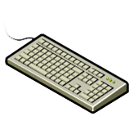

Virtual Machine Hardware
Parallel
port
Serial/Com
ports
USB controller
and USB devices
IDE controllers
Floppy controller
and floppy drives
Graphic card
Virtual Machine
Mouse
RAM
Keyboard
VM chipset with one or more CPUs
Network adapters
(NIC and HBA)
SCSI controllers
Virtualized Data Center – Compute
Notes:
A virtual machine uses a virtual hardware. Each guest operating system sees the hardware devices as if they were physical and owned by them. All virtual machines have standardized hardware. Standardized hardware makes virtual machine portable across physical machines.
Virtual machine can be configured with a virtual CPU, memory, and other virtual hardware devices such as virtual hard disk, virtual Ethernet cards, virtual CD/DVD drives, virtual floppy drives, USB controllers, and SCSI controllers. These components can be added while creating a new virtual machine or when required. In the current implementation of hypervisors, not all devices are available to add and configure; for example video devices cannot be added, but the available video device can be configured.
Copyright © 2011 EMC Corporation. Do not Copy - All Rights Reserved.

Slide 17
VM Hardware Components
Virtual Hardware | Description
vCPU | Virtual machine (VM) can be configured with one or more virtual CPUs Number of CPUs allocated to a VM can be changed
vRAM | Amount of memory presented to the guest operating system (OS) Memory size can be changed based on requirement
Virtual Disk | Stores VM's OS and application data A VM should have at least one virtual disk
vNIC | Enables a VM to connect to other physical and virtual machines
Virtual DVD/CD-ROM Drive | It maps a VM’s DVD/CD-ROM drive to either a physical drive or an .iso file
Virtual Floppy Drive | It maps a VM’s floppy drive to either a physical drive or an .flp file
Virtual SCSI Controller | VM uses virtual SCSI controller to access virtual disk
Virtual USB Controller | Maps VM’s USB controller to the physical USB controller
Virtualized Data Center – Compute
Notes:
A virtual machine (VM) can be configured with the following virtual components:
Virtual Central processing Unit (vCPU): A virtual machine can be configured with one or more vCPU when it is created. The number of vCPUs can be increased or decreased based on requirements.
Virtual Random Access Memory (vRAM): vRAM is the amount of memory allocated to a virtual machine. It is visible to a guest operating system. This memory size can be changed based on requirements.
Virtual Disk: A virtual disk stores the virtual machine's operating system, program files, application data, and other data associated with the virtual machine. A virtual machine should have at least one virtual disk.
Virtual Network Adaptor (vNIC): It provides connectivity between virtual machines on the same compute system, between virtual machines on different compute systems, and between virtual and physical machines. vNIC functions exactly like a physical NIC.
Virtual DVD/CD-ROM and floppy drives: These devices enable to map the virtual machines drive to either the physical drive or to the image file (such as .iso for CD/DVD and .flp for floppy) on the storage.
Virtual SCSI Controller: A virtual machine uses virtual SCSI controller to access virtual disks.
Virtual USB Controllers: Enables a virtual machine to connect to the physical USB controller and to access the USB device connected.
Copyright © 2011 EMC Corporation. Do not Copy - All Rights Reserved.

Slide 18
Virtual Machine Console
Provides mouse, keyboard, and screen functionality
Sends power changes (on/off) to the virtual machine (VM)
Allows access to BIOS of the VM
Typically used for virtual hardware configuration and troubleshooting issues
Virtualized Data Center – Compute
Notes:
A virtual machine (VM) console provides the mouse, keyboard, and screen functionalities. To install an operating system (OS), a virtual machine console is used. The virtual machine console allows access to the BIOS of the virtual machine. It offers the ability to power the virtual machine on/off and to reset it.
The virtual machine console is normally not used to connect to the virtual machine for daily tasks. It is used for tasks such as virtual hardware configuration and troubleshooting issues.
Copyright © 2011 EMC Corporation. Do not Copy - All Rights Reserved.

